Slide 1
Data Science Solution Design
Customer Segmentation for Insurance Provider

Slide 2
Agenda:
CRISP – DM Overview
Business Understanding
Data Understanding
Data Preparation
Model Building
Model Evaluation
Model Deployment

Slide 3
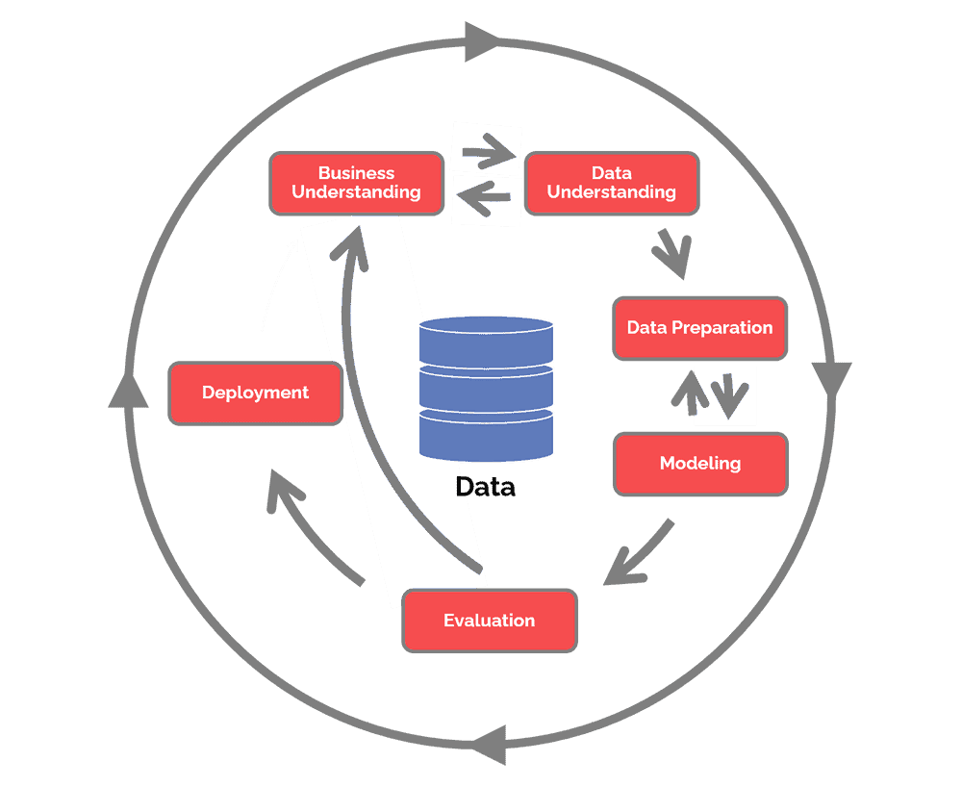
CRISP – DM Overview
Business Understanding
Key Questions
Data Understanding
Data discovery and Collection
Data QC
Data Exploration
Data preparation
Null Value Identification and Imputation
Feature Selection
Feature Transformation
Model building and evaluation
Model Building
Model Improvement
Evaluation - Offline and online
Model Deployment

Slide 4
Business Understanding
Key Questions:
What is the primary objective of the insurance provider for showing personalized ads to its customers?
What specific products or services are the personalized ads for?
What are the current segmentation approaches used by the insurance provider?
What are the current marketing channels used by the insurance provider?
What is the expected return on investment for the personalized ads?
How will the effectiveness of the personalized ads be measured and evaluated?
What is the budget for creating and delivering personalized ads?
What are the legal and regulatory considerations for personalized advertising?
What is the long-term strategy for personalized advertising and how will it evolve over time?
Notes:
The Business Understanding phase focuses on understanding the objectives and requirements of the project. Aside from the third task, the three other tasks in this phase are foundational project management activities that are universal to most projects:
Determine business objectives: You should first “thoroughly understand, from a business perspective, what the customer really wants to accomplish.” (CRISP-DM Guide) and then define business success criteria.
Assess situation: Determine resources availability, project requirements, assess risks and contingencies, and conduct a cost-benefit analysis.
Determine data mining goals: In addition to defining the business objectives, you should also define what success looks like from a technical data mining perspective.
Produce project plan: Select technologies and tools and define detailed plans for each project phase.
While many teams hurry through this phase, establishing a strong business understanding is like building the foundation of a house – absolutely essential.

Slide 5
Data Understanding
Data Discovery and Collection:
For customer segmentation of insurance provider, you need data such as:
Demographic data: This includes information such as age, gender, income, education, occupation, and marital status.
Geographical data: This includes location data such as the customer's city, state, and zip code.
Customer transaction data: This includes data on the customer's insurance policy history, claims history, and payment history.
Customer behaviour data: This includes data on the customer's browsing behaviour, interaction with online ads, and response to previous marketing campaigns.
Customer feedback data: This includes data on the customer's feedback on previous marketing campaigns, surveys, and customer service interactions.
Social media data: This includes data on the customer's social media activity, interests, and connections.
Third-party data: This includes data obtained from external sources such as credit bureaus, public records, and marketing data providers.
Ad campaign data: This includes data on previous advertising campaigns, such as impressions, clicks, and conversions
Notes:
The Business Understanding phase focuses on understanding the objectives and requirements of the project. Aside from the third task, the three other tasks in this phase are foundational project management activities that are universal to most projects:
Determine business objectives: You should first “thoroughly understand, from a business perspective, what the customer really wants to accomplish.” (CRISP-DM Guide) and then define business success criteria.
Assess situation: Determine resources availability, project requirements, assess risks and contingencies, and conduct a cost-benefit analysis.
Determine data mining goals: In addition to defining the business objectives, you should also define what success looks like from a technical data mining perspective.
Produce project plan: Select technologies and tools and define detailed plans for each project phase.
While many teams hurry through this phase, establishing a strong business understanding is like building the foundation of a house – absolutely essential.

Slide 6
Data Understanding
Target:
Understand the target of insurance provider:
Increasing customer engagement - Whether insurance company wants to capture the attention of customers and increase their engagement with the insurance provider's products and services by showing personalized ads.
Improving customer experience - Whether insurance provider want to provide customers with relevant and useful information, improving their experience and perception of the insurance provider by showing personalized ads.
Increasing conversion rates - Whether they want to show personalized ads to customers who are more likely to be interested in a particular product or service, the insurance provider can increase the chances of converting those customers into buyers..
Increasing customer loyalty – Whether insurance provider want to increase customer loyalty and retention by showing that they understand and care about their customer's needs.
Notes:
The Business Understanding phase focuses on understanding the objectives and requirements of the project. Aside from the third task, the three other tasks in this phase are foundational project management activities that are universal to most projects:
Determine business objectives: You should first “thoroughly understand, from a business perspective, what the customer really wants to accomplish.” (CRISP-DM Guide) and then define business success criteria.
Assess situation: Determine resources availability, project requirements, assess risks and contingencies, and conduct a cost-benefit analysis.
Determine data mining goals: In addition to defining the business objectives, you should also define what success looks like from a technical data mining perspective.
Produce project plan: Select technologies and tools and define detailed plans for each project phase.
While many teams hurry through this phase, establishing a strong business understanding is like building the foundation of a house – absolutely essential.

Slide 7
Data Understanding
Data QC
For customer segmentation of insurance provider, following quality checks can be performed:
Check the consistency of the customer segmentation data and ensure that it aligns with the business objectives.
Check for any outliers or anomalies in the data and determine if they need to be removed or handled differently.
Ensure that the data is structured in a consistent and standardized format for smoother analysis.
Check the data for any errors or inconsistencies introduced during the data collection process and address them.
Ensure that the data is representative of the target population and customer base.
Check the quality of any data obtained from surveys or questionnaires and ensure that they are relevant and useful for segmentation.
Ensure that the data is stored securely and backed up regularly to prevent loss or theft.
Check the quality of any data obtained from external sources and ensure that it is reliable and relevant for the segmentation analysis.
Check for any data quality issues that may arise due to data integration issues.
Notes:
The Business Understanding phase focuses on understanding the objectives and requirements of the project. Aside from the third task, the three other tasks in this phase are foundational project management activities that are universal to most projects:
Determine business objectives: You should first “thoroughly understand, from a business perspective, what the customer really wants to accomplish.” (CRISP-DM Guide) and then define business success criteria.
Assess situation: Determine resources availability, project requirements, assess risks and contingencies, and conduct a cost-benefit analysis.
Determine data mining goals: In addition to defining the business objectives, you should also define what success looks like from a technical data mining perspective.
Produce project plan: Select technologies and tools and define detailed plans for each project phase.
While many teams hurry through this phase, establishing a strong business understanding is like building the foundation of a house – absolutely essential.

Slide 8
Data Understanding
Data Exploration
For customer segmentation of insurance provider, following Data Exploration can be performed:
Univariate analysis: We can perform univariate analysis on each variable to get an idea about its distribution, skewness, outliers, and identify if any transformation is required.
Bivariate analysis: We can perform bivariate analysis on pairs of variables to identify any correlation or association between them.
Descriptive statistics: We can compute descriptive statistics for the variables to get an idea about the data distribution, mean, median, mode, standard deviation, etc.
Data visualization: We can use data visualization techniques such as histograms, scatterplots, boxplots, etc. to visualize the data distribution and identify any outliers , anomalies, trends and patterns in data.
Missing values identification: Identify any missing data and decide how to handle it.
Notes:
The Business Understanding phase focuses on understanding the objectives and requirements of the project. Aside from the third task, the three other tasks in this phase are foundational project management activities that are universal to most projects:
Determine business objectives: You should first “thoroughly understand, from a business perspective, what the customer really wants to accomplish.” (CRISP-DM Guide) and then define business success criteria.
Assess situation: Determine resources availability, project requirements, assess risks and contingencies, and conduct a cost-benefit analysis.
Determine data mining goals: In addition to defining the business objectives, you should also define what success looks like from a technical data mining perspective.
Produce project plan: Select technologies and tools and define detailed plans for each project phase.
While many teams hurry through this phase, establishing a strong business understanding is like building the foundation of a house – absolutely essential.

Slide 9
Data Preparation
Null Value Identification and Imputation
Feature Selection
Feature Transformation
Imputation Strategies
Numerical
KNN Imputer
Categorical
Iterative Imputer
Feature Selection Strategies
Mutual Information
Feature Transformation Strategies
Numeric – Normalization
Categorical – OHE, Label Encoding
Feature Reduction – PCA
No need to perform test split
Notes:
This phase, which is often referred to as “data munging”, prepares the final data set(s) for modeling. It has five tasks primarily:
Select data: Determine which data sets will be used and document reasons for inclusion/exclusion.
Clean data: Often this is the lengthiest task. Without it, you’ll likely fall victim to garbage-in, garbage-out. A common practice during this task is to correct, impute, or remove erroneous values.
Construct data: Derive new attributes that will be helpful. For example, derive someone’s body mass index from height and weight fields.
Integrate data: Create new data sets by combining data from multiple sources.
Format data: Re-format data as necessary. For example, you might convert string values that store numbers to numeric values so that you can perform mathematical operations.

Slide 10
Data Preparation
Model Building
Model Improvement
Evaluation - Offline and
online
Model
K-means
Hierarchical
DBSCAN
Elbow method
Hyperparameter tuning
Offline metrics:
Silhouette's Score
Davies-Bouldin Index (DBI)
Adjusted Rand Index (ARI)
Online metrics:
Click-Through Rate (CTR)
Conversion Rate
No need to perform test split
Notes:
This phase, which is often referred to as “data munging”, prepares the final data set(s) for modeling. It has five tasks primarily:
Select data: Determine which data sets will be used and document reasons for inclusion/exclusion.
Clean data: Often this is the lengthiest task. Without it, you’ll likely fall victim to garbage-in, garbage-out. A common practice during this task is to correct, impute, or remove erroneous values.
Construct data: Derive new attributes that will be helpful. For example, derive someone’s body mass index from height and weight fields.
Integrate data: Create new data sets by combining data from multiple sources.
Format data: Re-format data as necessary. For example, you might convert string values that store numbers to numeric values so that you can perform mathematical operations.

Slide 11
Challenges
One of the biggest issues with customer segmentation is data quality. Inaccurate data in source systems will usually result in poor grouping.
Insurance companies possess abundance of variables and factors that can be utilized for customer segmentation. Nonetheless, managing large amounts of data can be difficult, and it may be necessary to utilize dimensionality reduction methods to pinpoint the most significant variables.
Customer preferences and behaviour may change over time, making the segmentation model less effective.
The accuracy, completeness, and consistency of customer data could be a challenge.
Incomplete or inconsistent data may lead to incorrect segmentation, resulting in ineffective advertising.
Notes:
This phase, which is often referred to as “data munging”, prepares the final data set(s) for modeling. It has five tasks primarily:
Select data: Determine which data sets will be used and document reasons for inclusion/exclusion.
Clean data: Often this is the lengthiest task. Without it, you’ll likely fall victim to garbage-in, garbage-out. A common practice during this task is to correct, impute, or remove erroneous values.
Construct data: Derive new attributes that will be helpful. For example, derive someone’s body mass index from height and weight fields.
Integrate data: Create new data sets by combining data from multiple sources.
Format data: Re-format data as necessary. For example, you might convert string values that store numbers to numeric values so that you can perform mathematical operations.

Slide 12
Assumptions
Each cluster is homogenous, meaning that the customers within a cluster are similar to each other and different from those in other clusters.
There is a clear separation between the different clusters, meaning that the boundaries between the clusters are distinct and well-defined.
The distance between two points in feature space is measured using Euclidean distance.
The features selected are relevant to the clustering task.
Notes:
This phase, which is often referred to as “data munging”, prepares the final data set(s) for modeling. It has five tasks primarily:
Select data: Determine which data sets will be used and document reasons for inclusion/exclusion.
Clean data: Often this is the lengthiest task. Without it, you’ll likely fall victim to garbage-in, garbage-out. A common practice during this task is to correct, impute, or remove erroneous values.
Construct data: Derive new attributes that will be helpful. For example, derive someone’s body mass index from height and weight fields.
Integrate data: Create new data sets by combining data from multiple sources.
Format data: Re-format data as necessary. For example, you might convert string values that store numbers to numeric values so that you can perform mathematical operations.

Slide 13
Thank You
We Blend in to Create Results that Stand Out

